Slide 1
MERGE SORT
Divide and Conquer Algorithm
Presented by: Sumedha Jayesh Vanerkar
PRN: 25070521245
Division/Batch: E 2026
Symbiosis Institute of Technology, Nagpur
38 27 43 3
3 27 38 43
Generated using Canva AI

Slide 2
What Is Merge Sort?
An efficient, stable, comparison-based sorting technique
  Merge Sort is a sorting algorithm based on the Divide and Conquer technique.
  It divides an array into smaller subarrays.
  It continues dividing until each subarray contains only one element.
  It recursively sorts the smaller subarrays.
  It merges the sorted subarrays in the correct order.
  It produces a completely sorted array in ascending or descending order.
  It is a stable sorting algorithm when implemented correctly.
  It is suitable for sorting large datasets.
“Merge Sort is an efficient sorting algorithm that divides a problem into smaller parts and combines their sorted results.”
[38, 27, 43, 3] → [3, 27, 38, 43]
UNSORTED ARRAY
DIVIDE
SORT SMALLER
MERGE
SORTED ARRAY
Generated using Canva AI

Slide 3
Three Main Steps of Merge Sort
01
02
03
DIVIDE
CONQUER
COMBINE
Split the original array into two smaller halves repeatedly until each subarray contains one element.
Recursively sort the smaller subarrays. A single-element array is already sorted.
Merge the sorted subarrays by comparing their elements to produce one completely sorted array.
Original Array
Divide into Halves
Recursively Sort
Merge Halves
Final Sorted Array
Divide and Conquer makes a complex sorting problem easier by breaking it into smaller subproblems.
Generated using Canva AI

Slide 4
Phase 1 — Divide
Find the middle, split into halves, and repeat until every subarray has one element
LEVEL 1
LEVEL 2
LEVEL 3
LEVEL 4
[38, 27, 43, 3, 9, 82, 10, 5]
[38, 27, 43, 3]
[9, 82, 10, 5]
[38, 27]
[43, 3]
[9, 82]
[10, 5]
[38]
[27]
[43]
[3]
[9]
[82]
[10]
[5]
Generated using Canva AI

Slide 5
Phase 2 — Conquer
Recursion reaches the base case; then merging begins
• A single-element array is already sorted — this is the base case.
• Recursion turns one large sorting task into many small tasks.
• Once every branch reaches the base case, control returns upward and sorted pieces are merged.
BASE CASE
[38]
[27]
[43]
[3]
[9]
[82]
[10]
[5]
[27, 38]
[3, 43]
[9, 82]
[5, 10]
FIRST MERGE — sorted pairs
Generated using Canva AI

Slide 6
Phase 3 — Merge and Combine
Compare the front elements, select the smaller one, and copy any remainder
LEFT [27, 38]
RIGHT [3, 43]
1
Compare 27 and 3 → select 3
2
Compare 27 and 43 → select 27
3
Compare 38 and 43 → select 38
4
Copy remaining 43
FINAL MERGED ARRAY [3, 27, 38, 43]
Generated using Canva AI

Slide 7
Complete Working of Merge Sort
Blue divides downward • teal merges upward
[38, 27, 43, 3, 9, 82, 10, 5]
[38, 27, 43, 3]
[9, 82, 10, 5]
[38, 27]
[43, 3]
[9, 82]
[10, 5]
[38]
[27]
[43]
[3]
[9]
[82]
[10]
[5]
[27, 38]
[3, 43]
[9, 82]
[5, 10]
[3, 27, 38, 43]
[5, 9, 10, 82]
FINAL [3, 5, 9, 10, 27, 38, 43, 82]
Generated using Canva AI

Slide 8
Algorithm and Pseudocode
The recursive structure is short; the merge operation does the linear work
  Step 1: Start with the unsorted array and initialise the left and right indices.
  Step 2: Check whether the subarray contains more than one element.
  Step 3: Calculate the middle index of the subarray.
  Step 4: Divide the array into two halves using the middle index.
  Step 5: Recursively apply Merge Sort to the left half.
  Step 6: Recursively apply Merge Sort to the right half.
  Step 7: Merge both sorted halves by comparing their elements.
  Step 8: Copy the merged elements back into the original array to obtain the sorted array.
MERGE_SORT(A, left, right)
1. If left < right:
2. mid = floor((left + right) / 2)
3. MERGE_SORT(A, left, mid)
4. MERGE_SORT(A, mid + 1, right)
5. MERGE(A, left, mid, right)
START
left < right?
FIND MID
SORT LEFT
SORT RIGHT
MERGE
RETURN
Generated using Canva AI

Slide 9
Implementation of Merge Sort in C
Complete compilable program • two readable code panels
MERGE FUNCTION
MERGESORT + MAIN
#include <stdio.h>
void merge(int a[], int l, int m, int r) {
int i = l, j = m + 1, k = 0;
int temp[r - l + 1];
while (i <= m && j <= r) {
if (a[i] <= a[j])
temp[k++] = a[i++];
else
temp[k++] = a[j++];
}
while (i <= m)
temp[k++] = a[i++];
while (j <= r)
temp[k++] = a[j++];
for (i = l, k = 0; i <= r; i++, k++)
a[i] = temp[k];
}
void mergeSort(int a[], int l, int r) {
if (l < r) {
int m = l + (r - l) / 2;
mergeSort(a, l, m);
mergeSort(a, m + 1, r);
merge(a, l, m, r);
}
}
int main(void) {
int a[] = {38, 27, 43, 3, 9, 82, 10, 5};
int n = sizeof(a) / sizeof(a[0]);
mergeSort(a, 0, n - 1);
printf("Sorted array: ");
for (int i = 0; i < n; i++)
printf("%d ", a[i]);
printf("\n");
return 0;
}
Generated using Canva AI

Slide 10
Results and Analysis
Correct output, predictable complexity, practical strengths
A. PROGRAM OUTPUT
B. COMPLEXITY ANALYSIS
Sorted array: 3 5 9 10 27 38 43 82
BEST CASE O(n log n)
AVERAGE CASE O(n log n)
WORST CASE O(n log n)
The program sorts the input array in ascending order.
Space: O(n)
T(n) = 2T(n/2) + O(n)
Master theorem → O(n log n)
C. ADVANTAGES & APPLICATIONS
✓ Guaranteed O(n log n) time
✓ Stable when implemented correctly
✓ Effective for large datasets
✓ Predictable performance
APPLICATIONS
Large datasets • external sorting
linked lists • stable sorting needs
LIMITATION
Requires O(n) extra array memory
Generated using Canva AI

Slide 11
Summary of Merge Sort
• Based on Divide and Conquer
• Divides an array into smaller subarrays
• Recursively sorts each subarray
• Merges pieces into one sorted array
• Best / average / worst: O(n log n)
• Auxiliary space: O(n)
• Stable when equal elements are handled correctly
“Merge Sort demonstrates how dividing a complex problem into smaller subproblems can produce an efficient and reliable solution.”
UNSORTED
DIVIDE
SORT SMALLER
MERGE
SORTED
Generated using Canva AI

Slide 12
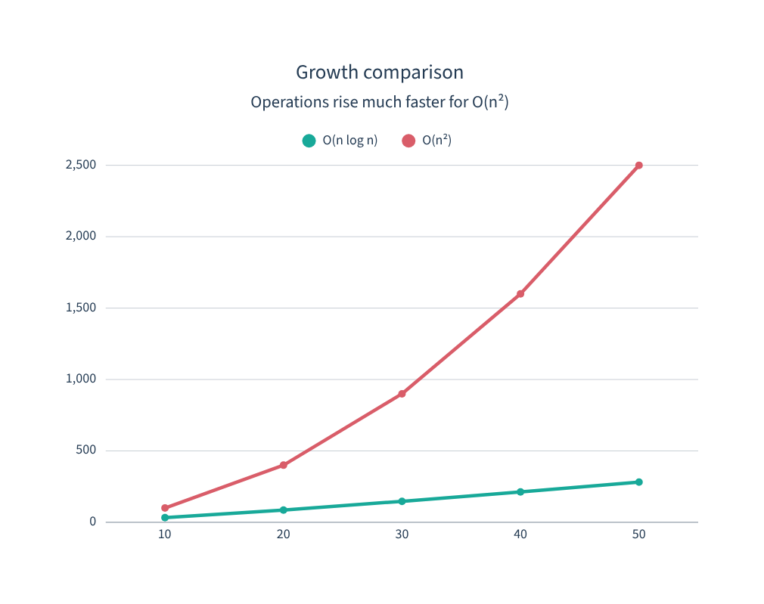
Key Benefits and Final Understanding
Why Merge Sort scales better than simple quadratic sorting
• Consistent performance regardless of input order
• Suitable for large arrays and linked lists
• Systematic merging of sorted sequences
• Stability preserves equal elements’ order
• Predictable complexity supports reliable design
MERGE SORT
O(n log n) time
O(n) space
BUBBLE SORT
O(n²) average & worst
O(1) space
Generated using Canva AI

Slide 13
THANK YOU!
Design and Analysis of Algorithms | Merge Sort • Generated using Canva AI

